Slide 1


SCHOLA
Online Classroom Management
A One-Stop solution to manage schedules and lecture materials for students
Notes:
Creadit picture : Unsplash Photo by Chris Yang
Link : https://unsplash.com/photos/1BtAeOohu1A Photo by Vidar Nordli-Mathisen
Link : https://unsplash.com/photos/xqMM3KoR7oI
1

Slide 2






Andromeda
SCHOLA
Our team
We are working with the aim of providing the best software suited to our client’s needs.
Context
Objectives
Features
Technical Requirements
Timeline
ERD
Tasnim Ferdous
180041108
Sidratul Muntaha
180041118
Farhan Ishmam
180041120
2
Notes:
Creadit picture : Photo by Anthony Intraversato on Unsplash Link : https://unsplash.com/photos/vYRAP3yMa3I
2

Slide 3

SCHOLA
Our Team
Crisis in Pandemic!
Context
Objectives
Due to the long-term lock-down and continuation of online classes, students face a number of problems which include, but are not limited to:
Problems in finding the correct class links in time
Not receiving notices on quizzes and classes
Juggling multiple online platforms
Different groups receiving unrelated notices
Losing track of current lecture status and quiz syllabus
Not finding shared lecture materials
Features
Technical Requirements
Timeline
ERD
3
Notes:
Creadit picture : Photo by Ethan Haddox on Unsplash Link : https://unsplash.com/photos/jvUZkoh4Hhw
3

Slide 4

SCHOLA
Our Team
Client Requirements
Context
Allow Students to keep track of their class links
Send out notices filtered by groups
Allow Class Representatives and teachers to manage and send information to students
Allow sharing of class materials and lecture notes
Allow students to make personal notes and/or record their progress in individual courses
Allow access at any time through any platform
Objectives
Features
Technical Requirements
Timeline
ERD
4

Slide 5
SCHOLA
Our Team
Personal lecture Evaluation Sheet
Context
To-do List
Objectives
Individual Class Schedule
Overall Features
Features
Class Test and Exam dates
Technical Requirements
Role Based User Access
Timeline
Notices
ERD
5
Notes:
5

Slide 6
SCHOLA
Operating System
Hardware
Our Team
Any as it is a Web-Based Application
Database Server
Website Hosting Server
Context
Objectives
Technical Requirements
Features
Language
Software
Technical Requirements
Java Script (JS)
Hyper Text Markup Language (HTML)
Cascading Style Sheet (CSS)
Structured Query Language (SQL)
Browser
IDE
MySQL
Timeline
ERD
6
Notes:
Creadit picture :
Photo by Jordan on Unsplash Link : https://unsplash.com/photos/evtWtv0i-6E
6

Slide 7
Week 1
Week 2
Week 3
Week 4
Week 5
Week 6
Week 7
Week 8
SCHOLA
Problem Analysis
Our Team
Database Design
Context
User Interface Design
Data Collection
Objectives
Developing Core UI
Features
Implementing Database
Technical Requirements
Data Entry
Adding Features
Timeline
Integration and Deployment
ERD
Support and Maintenance
7
Notes:
7

Slide 8
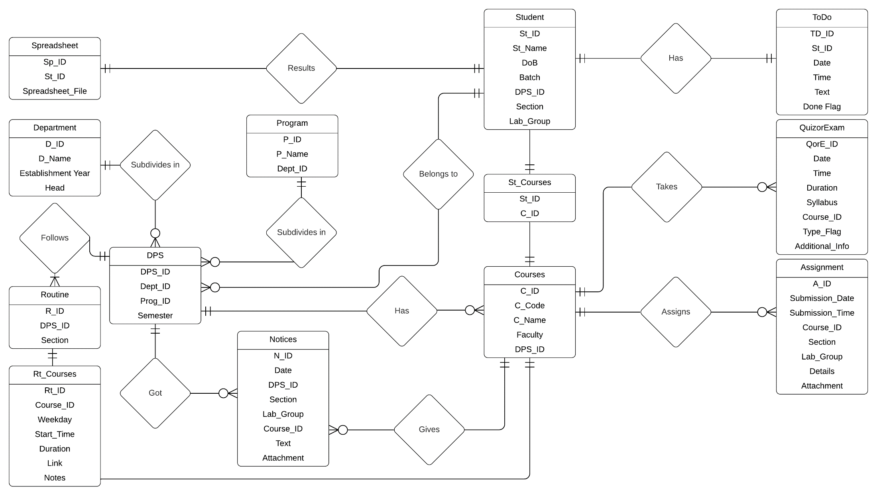
SCHOLA
Our Team
Context
Objectives
Features
Technical Requirements
Timeline
ERD
8
Notes:
8

Slide 9
THANK
YOU
Notes:
9

